Slide 1
Truncation Errors and Tailors Series
1
Chapra: Chapter-4

Slide 2
Truncation Error
Truncation errors are those that result from using an approximation in place of an exact mathematical procedure.
Example:
How much error is introduced with this approximation?
We can use Tailors Series to estimate truncation error.

Slide 3
Tailors Series
n^{th} order approximation
(x_{i+1}-x_{i})= h step size (define first)
Reminder term, R_{n}, accounts for all terms from (n+1) to infinity.

Slide 4
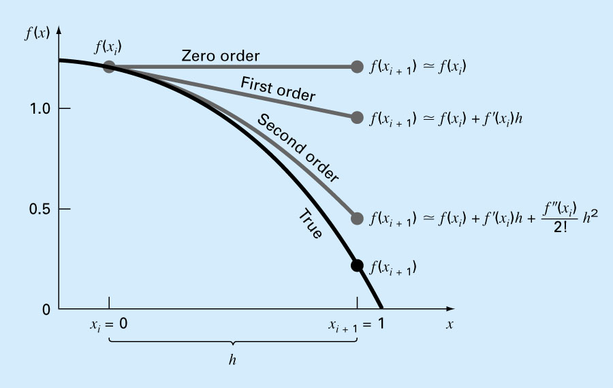
The approximation of f(x) at x=1 by zero-order, fist-order and second-order Tailor series expansion

Slide 5
Insight
Each additional term contributes to the approximation
n^{th}-order Tailor Series gives exact value of n^{th}-order polynomial
Inclusion of a few terms gives an approximation that is good enough for practical purpose.
The Remainder:
ε is not exactly known.
Need to determine f^{n+1}(x_{i+1}), which require the determination of the (n+1)th derivative of f(x). If we know f(x) then we do not need to use Tailors series!
Yet, R_{n}=O(h^{n+1}) gives insight into error. E.g., if error is O(h) then halving step size will halve the error. If error is O(h²) then halving the step size will quarter the error, and so on.

Slide 6
Effect of Step Size
Estimate
t | Actual | Estimate | Error%
0 | 0 | 0
1 | 8.962318 | 9.81 | 9.458288
2 | 16.42172 | 17.81934 | 8.510793
3 | 22.63024 | 24.35854 | 7.637128
4 | 27.79763 | 29.69744 | 6.834436
5 | 32.09849 | 34.05637 | 6.099607
6 | 35.67812 | 37.6152 | 5.429315
7 | 38.65748 | 40.52079 | 4.820066
8 | 41.13722 | 42.89306 | 4.268249
9 | 43.20112 | 44.82988 | 3.770176
10 | 44.91893 | 46.4112 | 3.322138
11 | 46.34867 | 47.70225 | 2.920443
12 | 47.53865 | 48.75633 | 2.561458
13 | 48.52908 | 49.61693 | 2.241647
14 | 49.35343 | 50.31957 | 1.957596
15 | 50.03953 | 50.89323 | 1.706043
16 | 50.61058 | 51.36159 | 1.483897
Actual
t | Actual | Estimate | Error%
0 | 0 | 0
2 | 16.42172 | 19.62 | 19.47591
4 | 27.79763 | 32.03736 | 15.25213
6 | 35.67812 | 39.89621 | 11.82263
8 | 41.13722 | 44.87003 | 9.074043
10 | 44.91893 | 48.01792 | 6.899074
12 | 47.53865 | 50.01019 | 5.199019
14 | 49.35343 | 51.27109 | 3.885579
16 | 50.61058 | 52.06911 | 2.881848
m= | 68.1
c= | 12.5
9= | 9.81
∆t= | 2

Slide 7
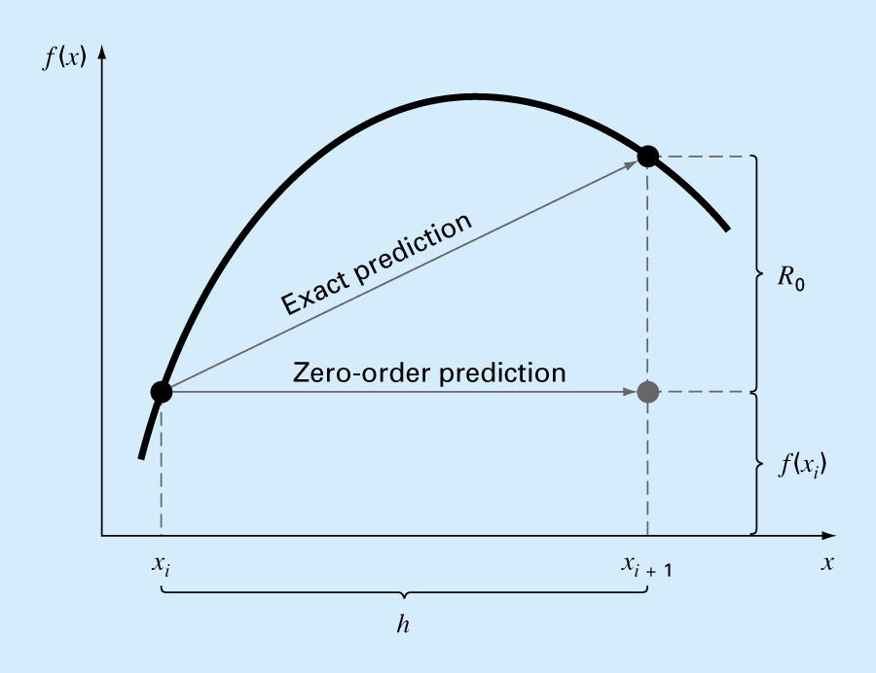
Insight : R_{n}

Slide 8
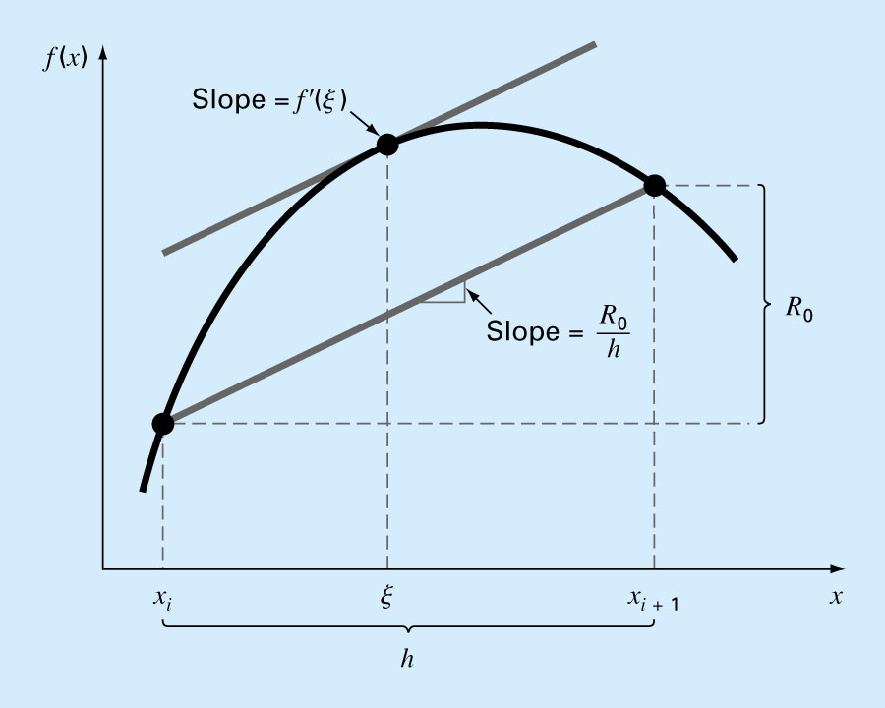
Insight : R_{n}

Slide 9
How to get derivatives?
We will be given value of unknown f(x) for some value of x
We can estimate f^{n}(a), i.e. the n^{th} order derivate of f(x) at x=a numerically without knowing f(x)

